Slide 1
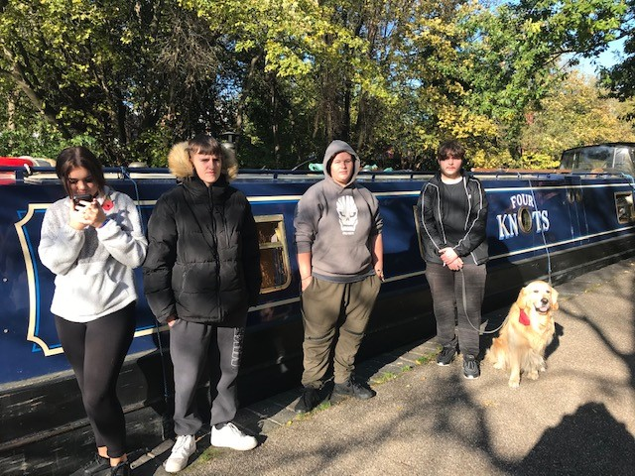
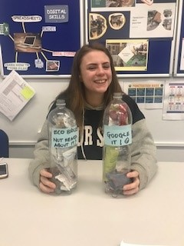
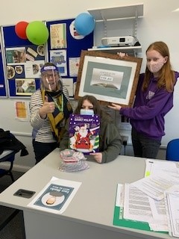
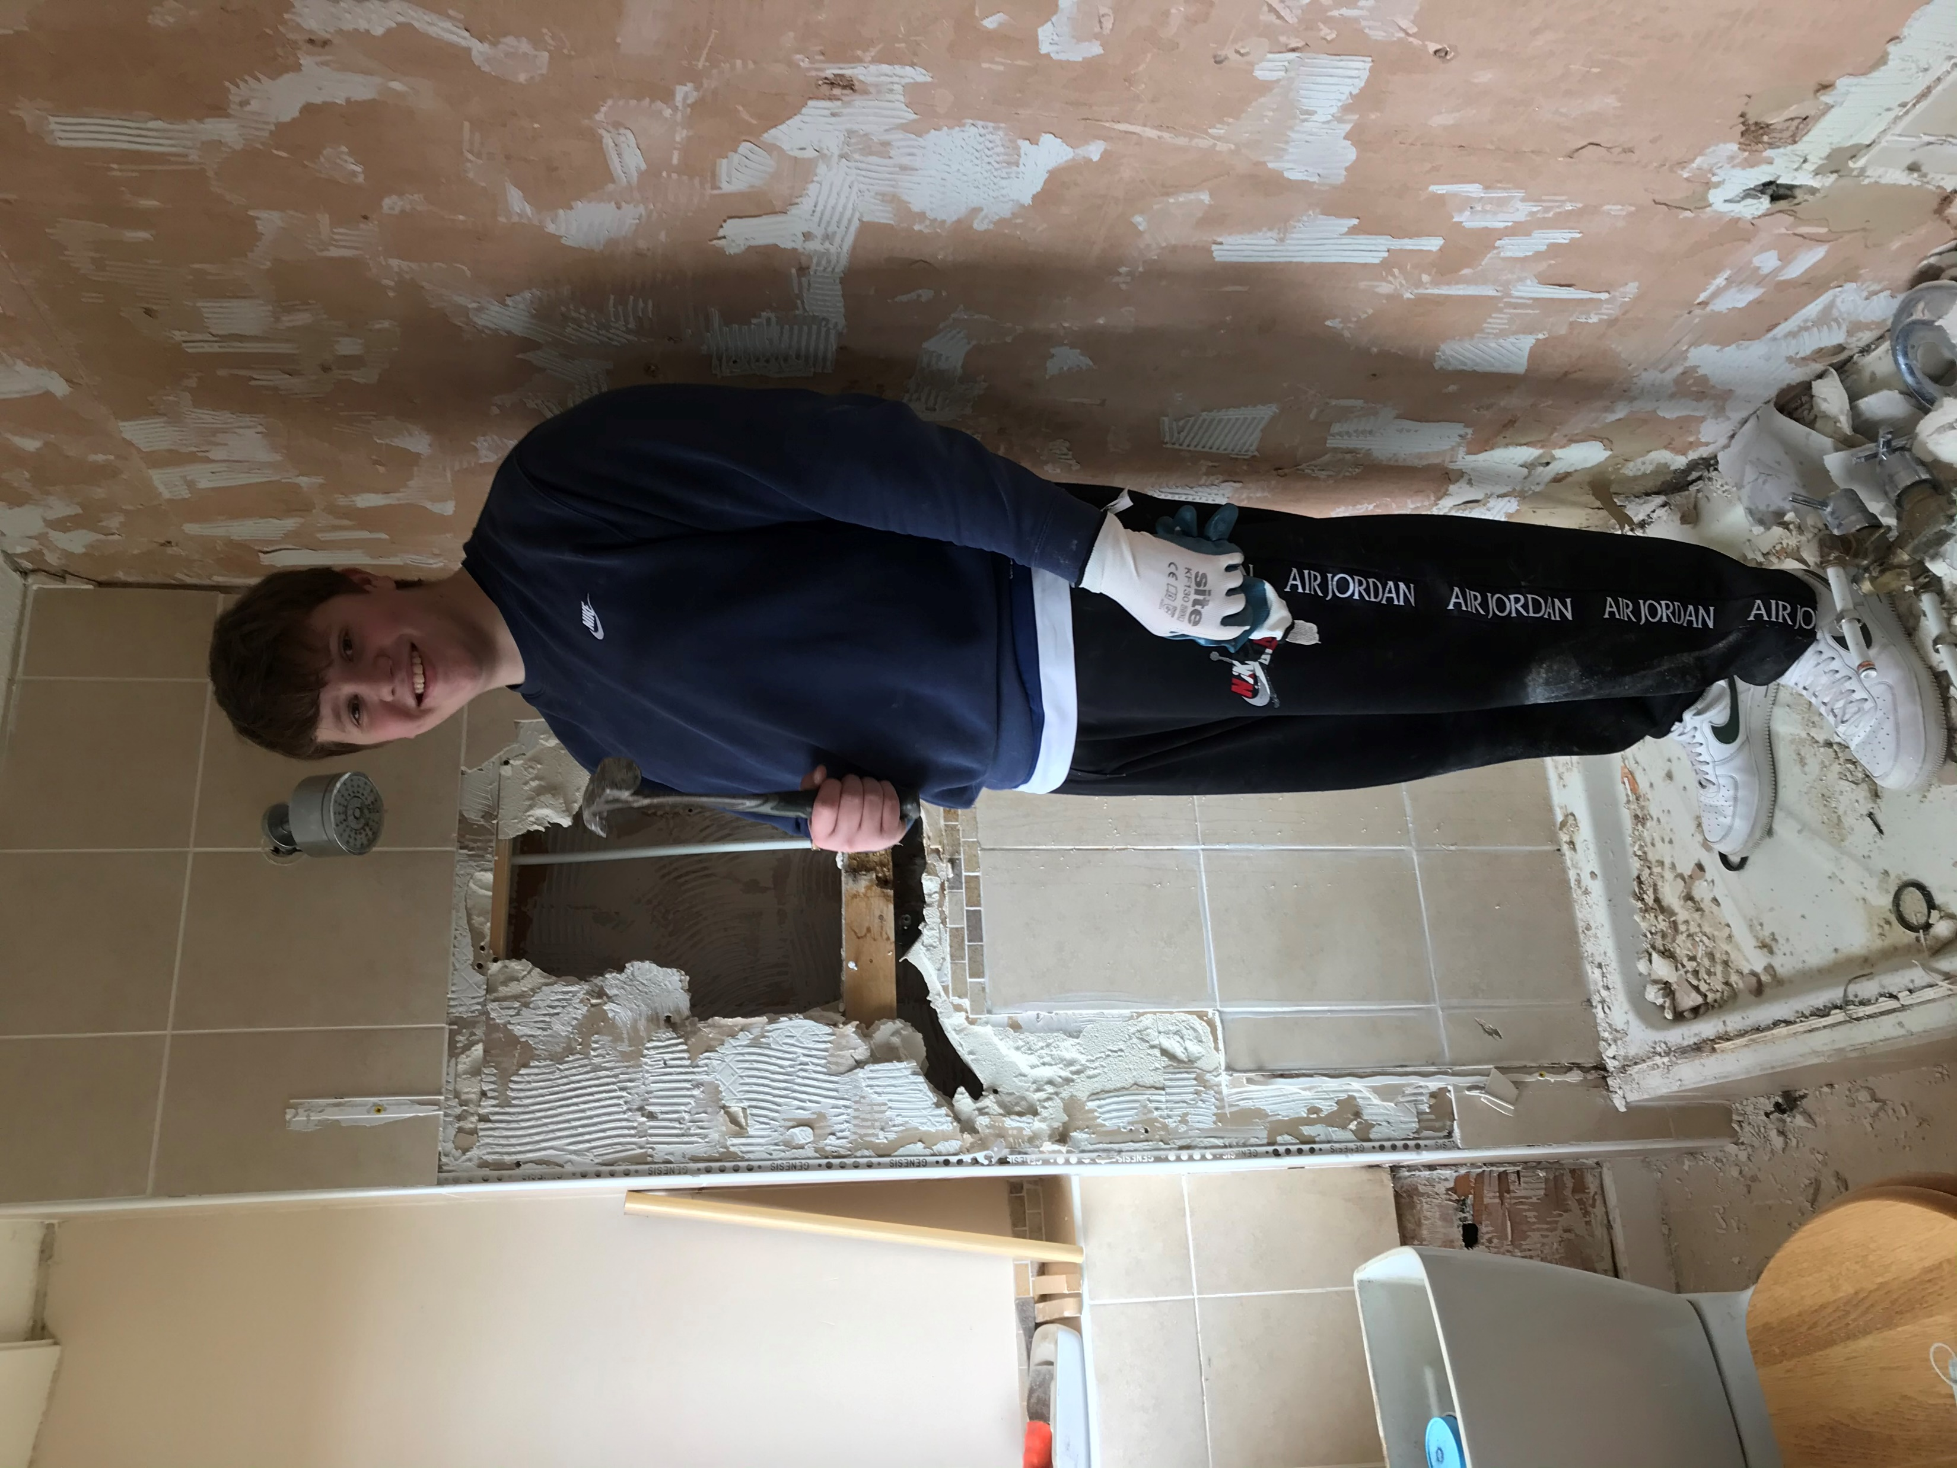
Traineeships
‘Pathway to Payday’
Jo Thomson, Engagement Manager
and
Emma Stewart, Skills Manager
The Traineeship has helped to advise me about future career choices.

Slide 2
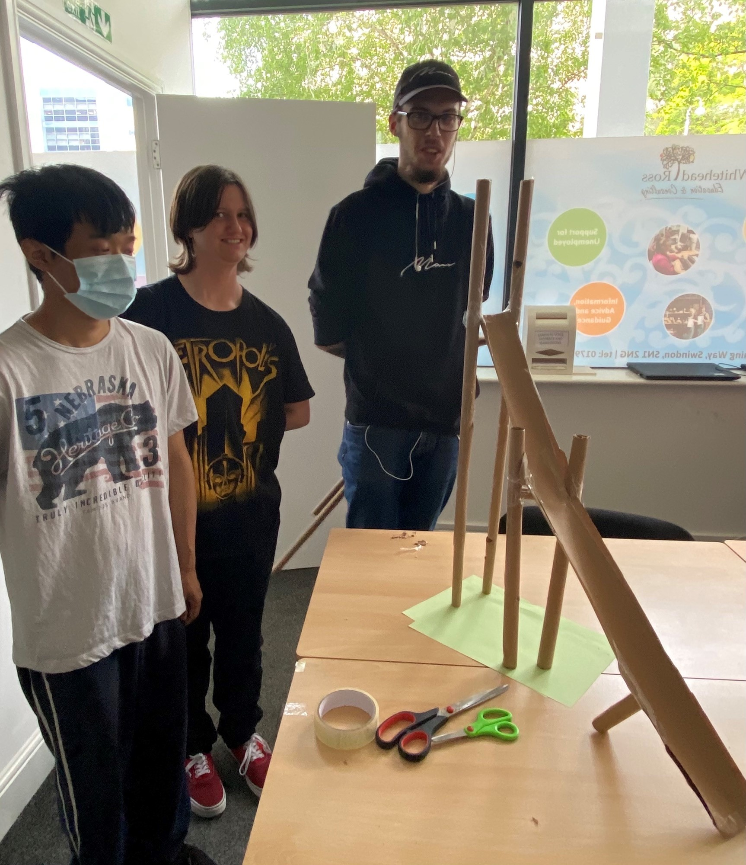
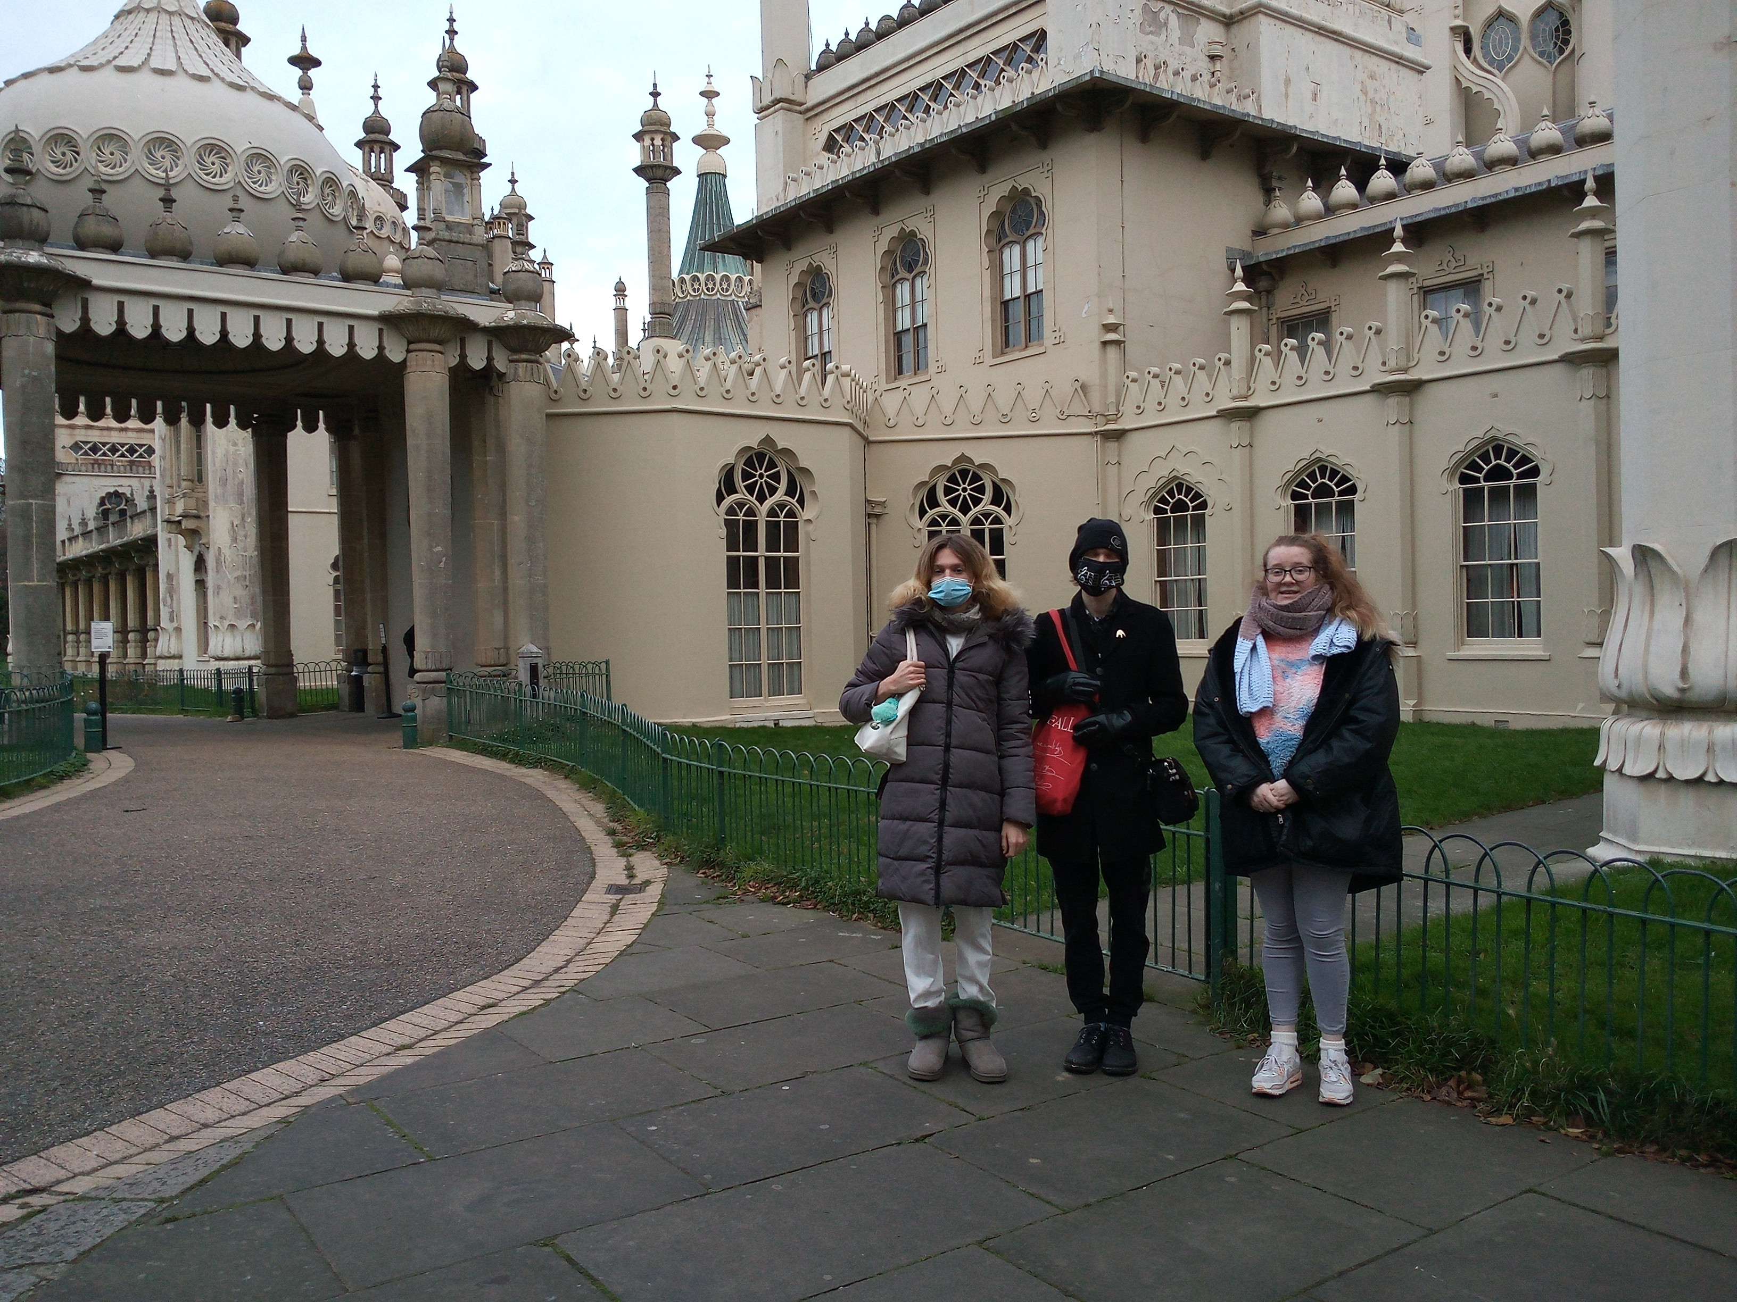
Flexible Traineeship Programme for
16-24 Year Olds.
Join anytime
Up to 6 month programme
15 hours per week – classroom based
Maths and English Functional Skills
Employability and Life Skills
Digital Skills
70 hours total voluntary work experience (approx. 2 days per week)
Matched to suit skills, interests and future career plans
I have enjoyed making new friends since starting the Traineeship.
PROGRESSION ROUTE INTO KICKSTART, APPRENTICESHIP OR PAID EMPLOYMENT

Slide 3
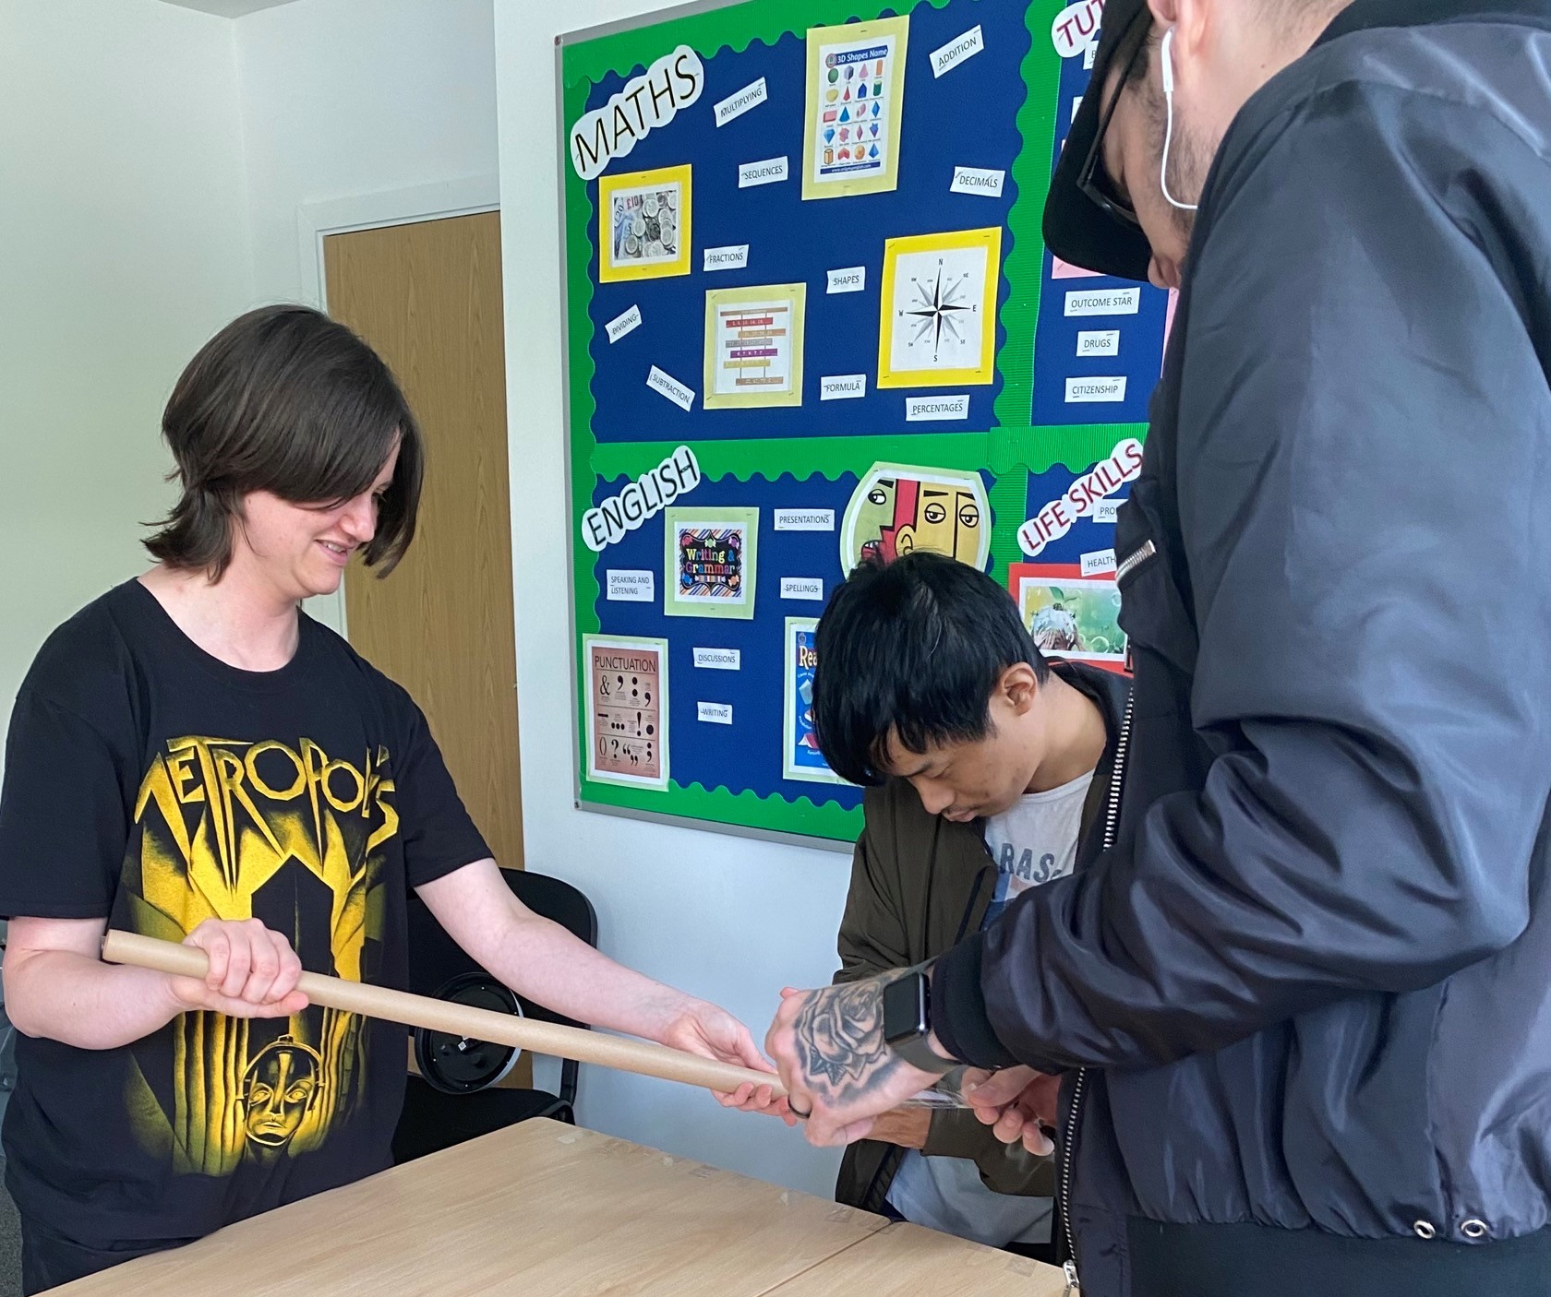
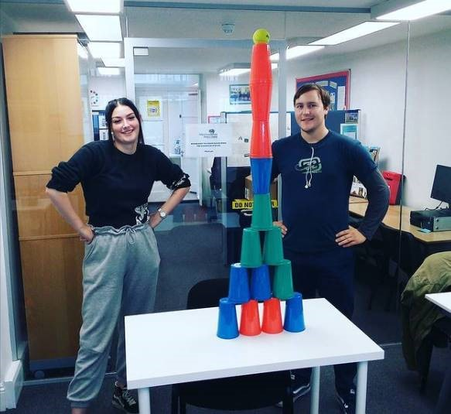
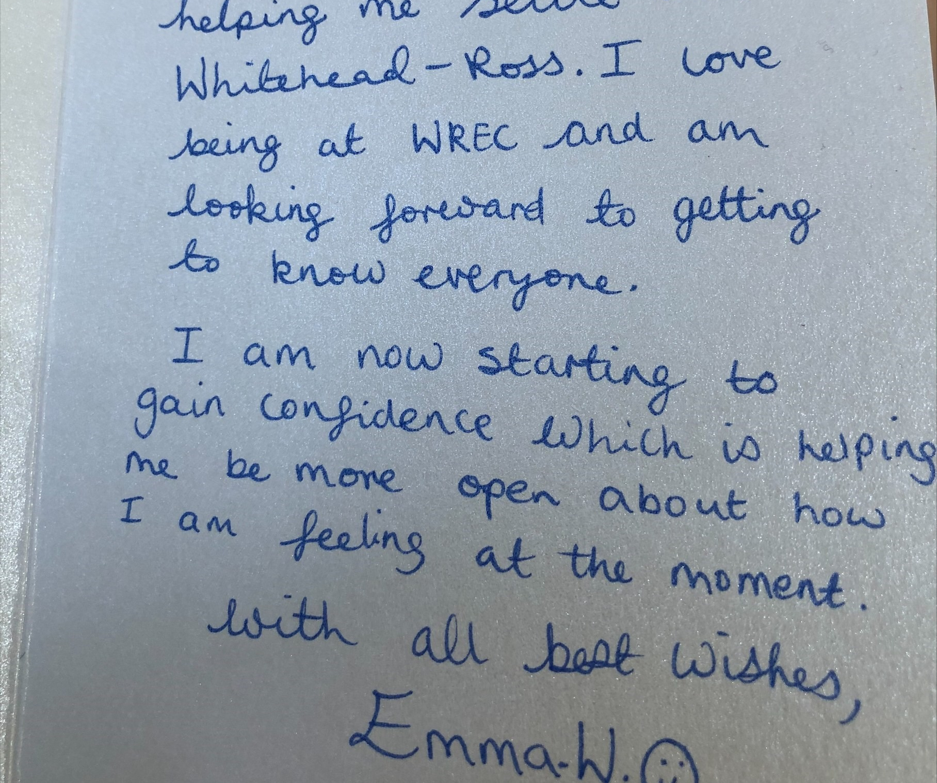

Slide 6
Email traineeships@wrecltd.co.uk
Telephone – 07387 269779

